Slide 1
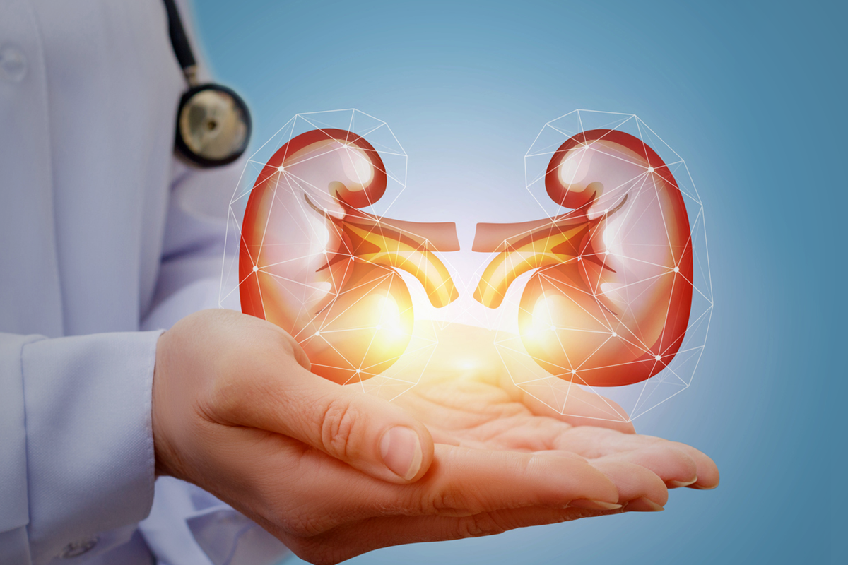
Surgery of Kidney

Slide 2
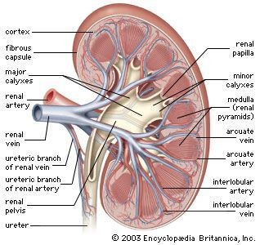
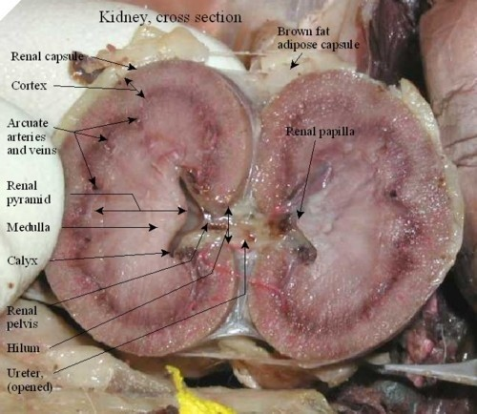
Surgery of kidneys tends to focus on
extracting calculi, and
providing treatment for traumatic injury or neoplastic conditions.
The function of the kidneys are
removal of metabolic waste products,
maintenance of normal fluid balance, and
regulation of blood pressure

Slide 3
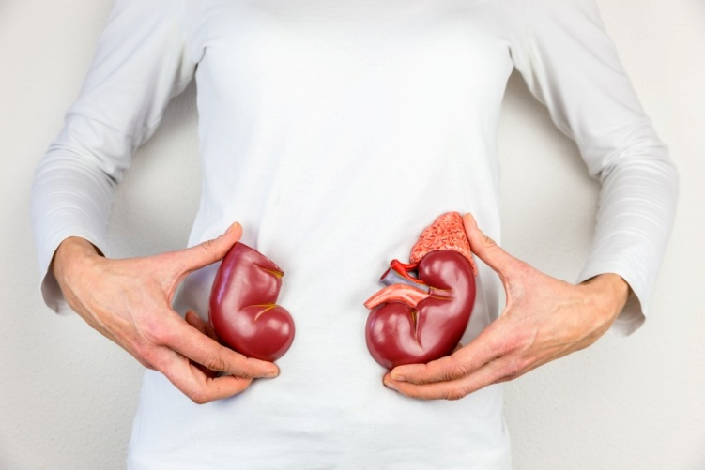
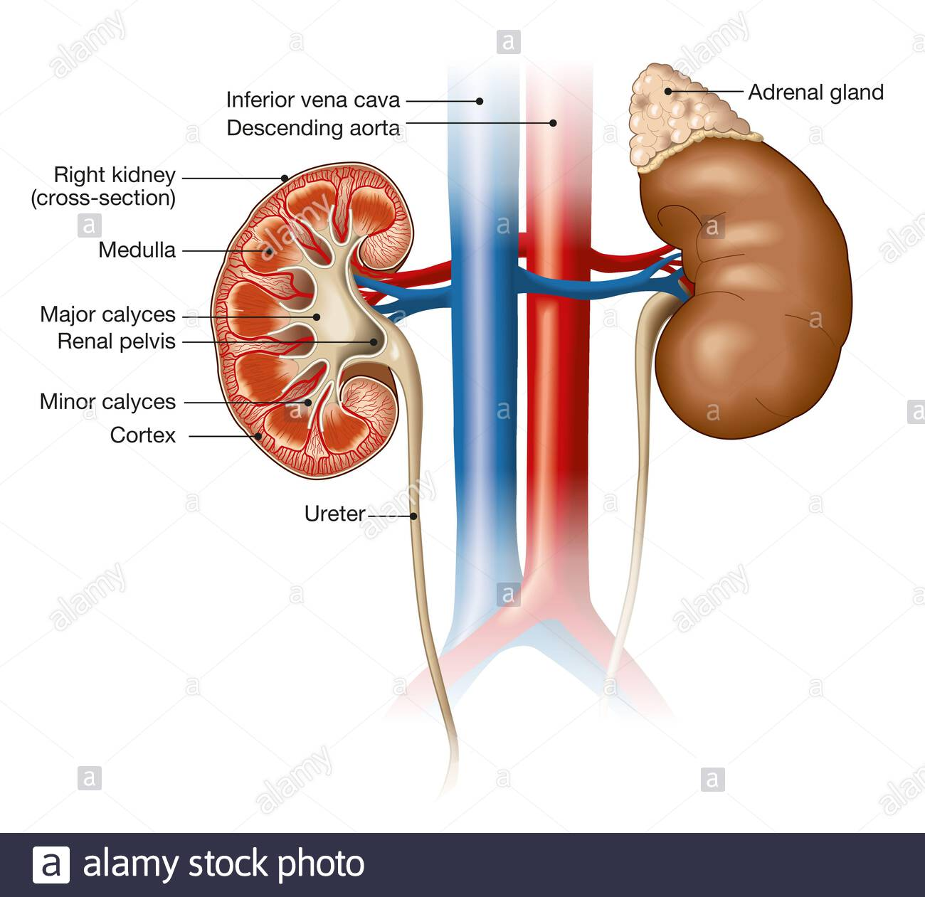
Anatomy:
The kidneys are located in the retroperitoneal space directly beneath the sublumbar muscles.
The left kidney is generally more mobile than the right kidney
The kidney is covered by fibrous capsule, it is divided into the outer cortex (is composed of glomeruli and adjacent structures) and the inner medulla (is striated in appearance and projects into the renal pelvis as the renal crest).
The renal arteries arise of the abdominal aorta. The renal vein returns blood back into the caudal vena cava.

Slide 4
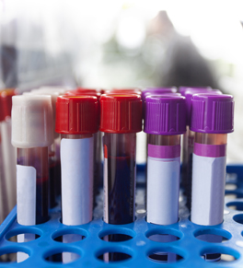
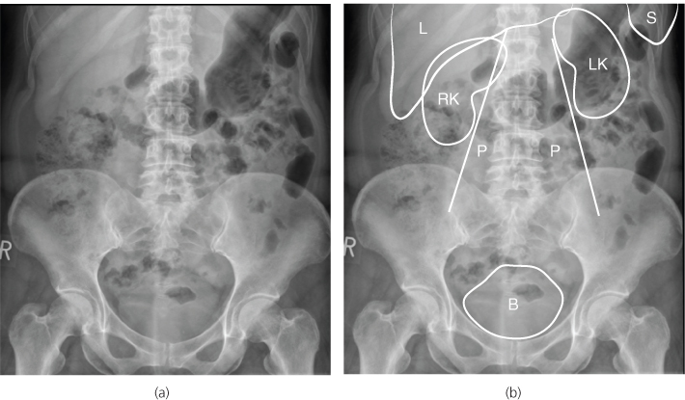
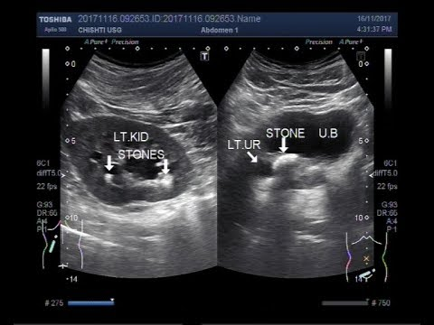
PERIOPERATIVE MANAGEMENT
Diagnostic Tests: A complete blood count, biochemistry and coagulation panels, urinalysis, urine culture, and blood pressure should be evaluated.
Renal Imaging
a. Abdominal radiographs and renal ultrasonography are performed in most affected animals to evaluate renal structure, identify and locate calculi, examine the kidneys and other organs for primary or metastatic neoplasia, and obtain fluid or tissue samples.

Slide 5
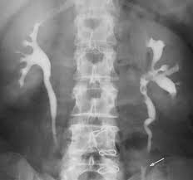
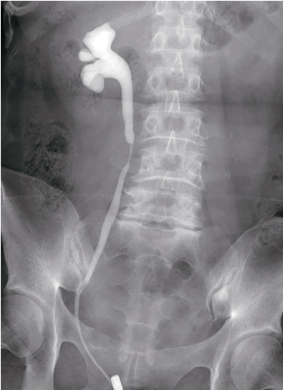
b. Intravascular Contrast Studies Radiographic imaging of the kidney can be enhanced by administration of intravenous (IV) contrast agents that are filtered or excreted by the urinary system. The resulting study is called an excretory urogram or intravenous pyelogram.
c. Pyelography: direct injection into the renal pelvis.This procedure is indicated when there is concern about giving a systemic dose of contrast or when the renal artery is obstructed.

Slide 6
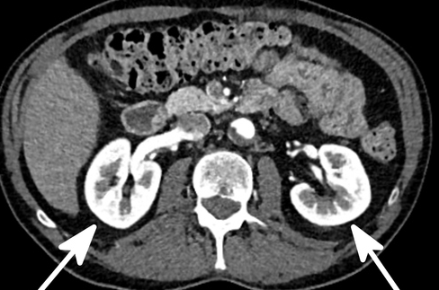
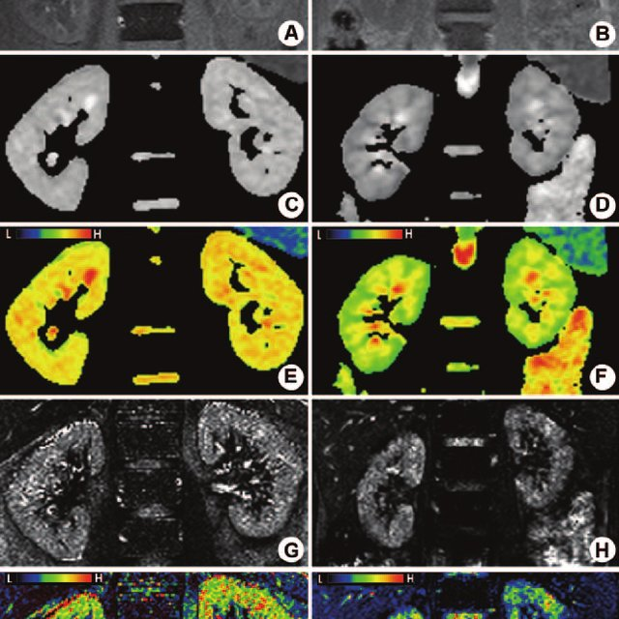
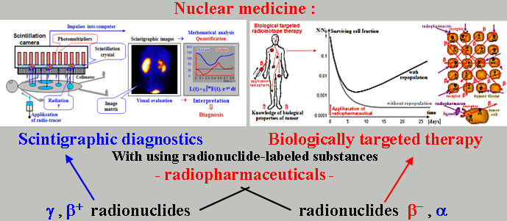
d. Computed Tomography provides good images of the kidney, particularly when contrast enhancement is performed.
e. Magnetic Resonance Imaging Contrast-enhanced magnetic resonance angiography (MRA) has been used for quantitative and qualitative evaluation of renal vessels in humans
f. Scintigraphyis used to determine the glomerular filtration rate of the kidney.

Slide 7
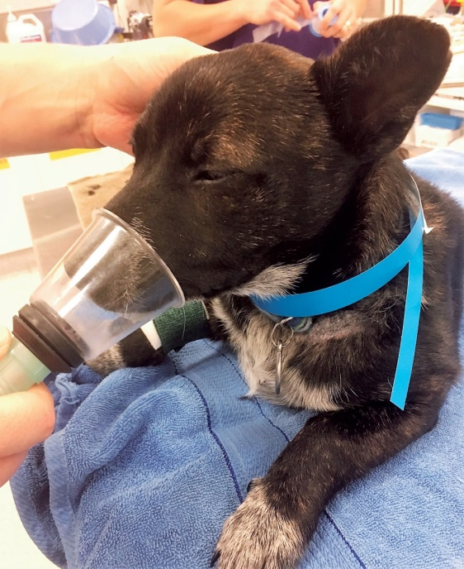
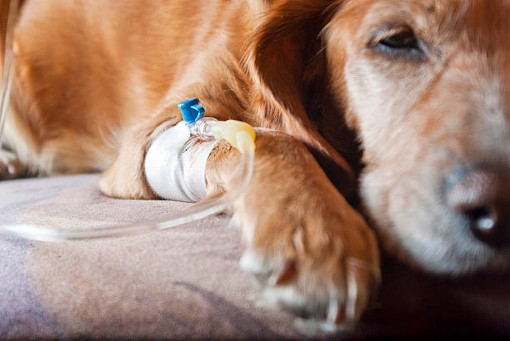
Anesthesia: Animals with renal dysfunction are induced with IV propofol or an inhalant anesthetic delivered by mask. Anesthesia is maintained with isoflurane or sevoflurane, and blood pressure and urine output should be monitored during the procedure.
Postoperative Care
Intravenous fluids are continued after surgery to maintain renal perfusion and prevent blood clot formation within the urinary tract. Postoperative analgesia can be delivered by intermittent intravenous injections or a constant rate infusion of opioids.

Slide 8
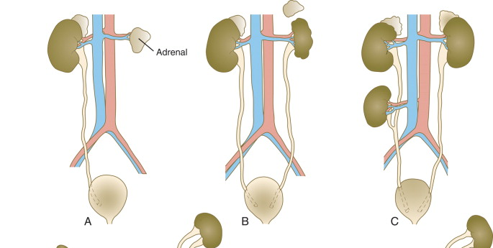
ABNORMALITIES OF THE KIDNEY
1. Developmental Anomalies
a. Renal Agenesis
During development, the kidneys normally “ascend” from the pelvic region to the level of the thoracolumbar junction. Ectopic kidneys are usually found within the pelvic area, although they may be found anywhere along the normal path of ascension or even in the thorax.
Ectopic kidneys should function normally and may be found incidentally during routine abdominal imaging or exploratory surgery.

Slide 9
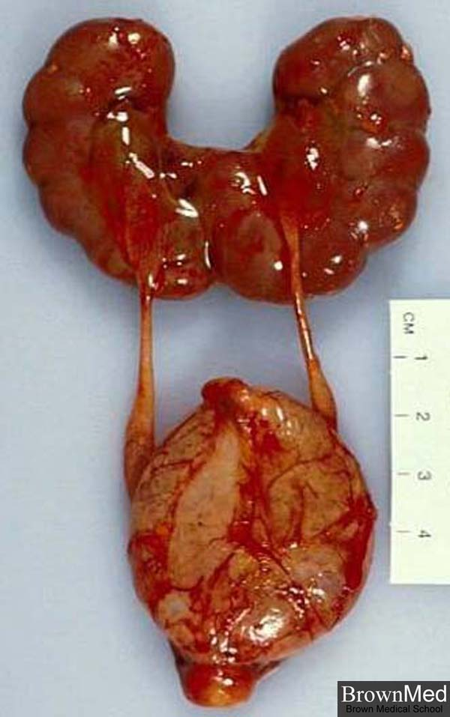
b. Fused Kidney
Results from convergence of the developing kidneys as they ascend. The fused kidney is often shaped more like a horseshoe rather than the more typical bean shape. Most fused kidneys function normally.

Slide 10
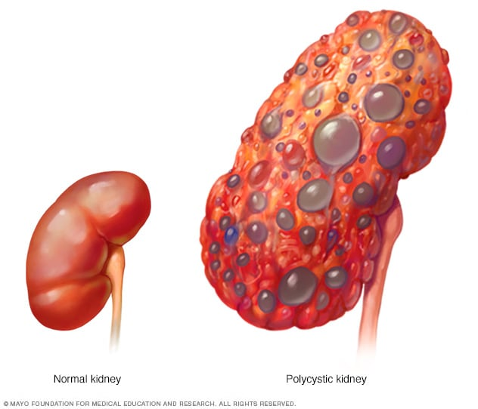
c. Polycystic Kidney Disease
It is a common finding in Persian cats and breeds originating from Persian cats, The cysts form from renal tubular cells that eventually become separated from the originating nephron.
In the end, slow progression of polycystic renal disease leads to renal failure as a result of expansion of cysts with subsequent compression of surrounding parenchyma and development of chronic interstitial lesions
Percutaneous aspiration provides temporary relief.

Slide 11
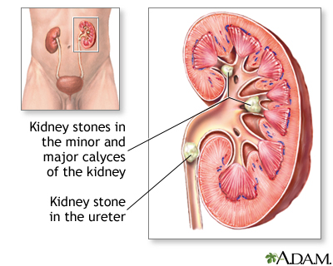
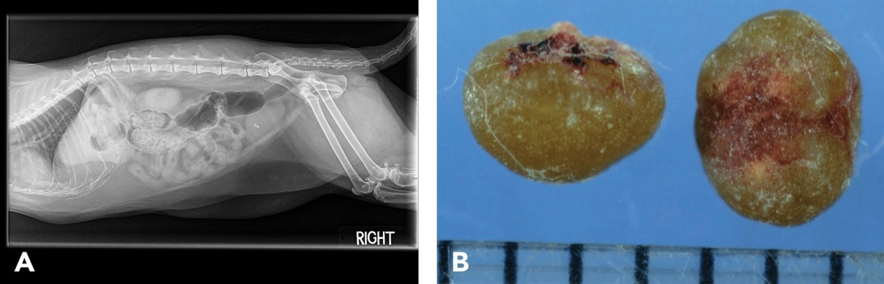
2. Renal Calculi
Renal calculi (nephroliths or renoliths) form because of oversaturation of urine with calculogenic substances.
Plasma concentrations of calculogenic substances may be increased by a variety of causes such as:
organ dysfunction (e.g., hyperammonemia secondary to liver disease or enzyme deficiency),
neoplasia (e.g., hypercalcemia secondary to parathyroid tumors or paraneoplastic syndrome),
increased calcium intake,
impaired renal reabsorption, and

Slide 12
The incidence of nephroliths is apparently increasing in dogs and cats
Notice: one of the most frequent reasons for performing renal surgery.
Most calculi are composed of calcium salts (calcium oxalates, calcium phosphates).
Radiographs may be useful because most of the renal calculi are radiopaque, calculi will be detectable on ultrasonography
Treatment:
Nephroliths are most commonly composed of calcium oxalate and cannot be dissolved with medical protocols. Treatment options for stone removal include lithotripsy, nephrotomy
Nephrectomy should be considered in animals with a unilateral severely hydronephrotic, infected, or nonfunctional kidney.

Slide 13
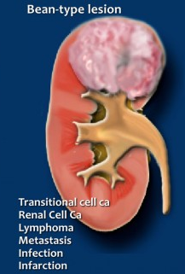
3. Renal Neoplasia
Types of Neoplasia
Primary renal tumors are uncommon in dogs and cats, accounting for less than 2% of all tumors. The majority of primary renal tumors are malignant.
Lymphoma is the most common renal tumor in cats. Renal cell carcinoma is the most common kidney tumor in dogs

Slide 14
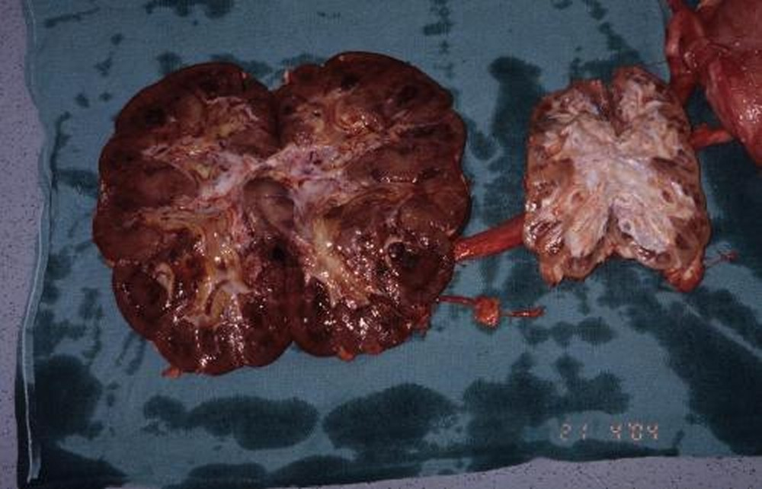
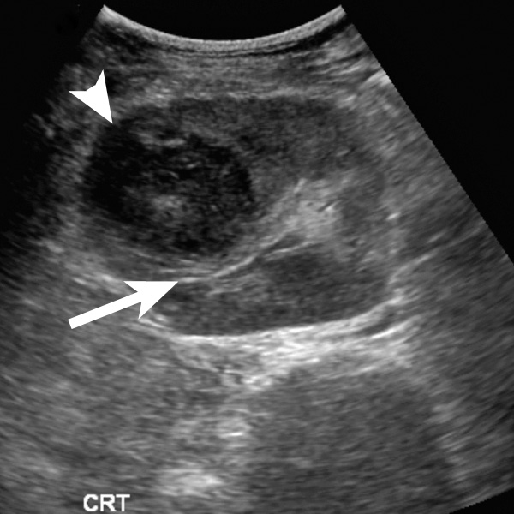
4. Renal Abscesses
Renal abscesses are rare in dogs.
An abscess may develop within renal parenchyma or surrounding the kidney (peri nephric abscessation).
The diagnosis is made on ultrasonography with confirmation of the abscess based on fluid cytology and culture.
Treatment includes supportive care and nephrectomy.

Slide 15
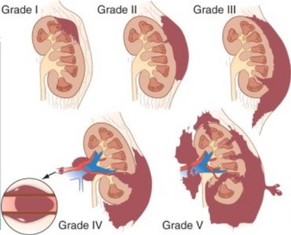
5. Renal Trauma
Reports of renal trauma are extremely rare in the veterinary literature
The kidney, or its blood supply, can be injured by blunt trauma, such as vehicular accidents, or by sharp penetration with projectiles, animal bites.
Trauma can result in capsular tears, parenchymal fractures, perirenal or renal hematomas, crush injuries, vascular avulsion, or renal prolapse.
In humans, extensive renal damage has been successfully managed conservatively, and devascularized kidneys may be left in place to atrophy

Slide 16
Surgery of Ureters

Slide 17
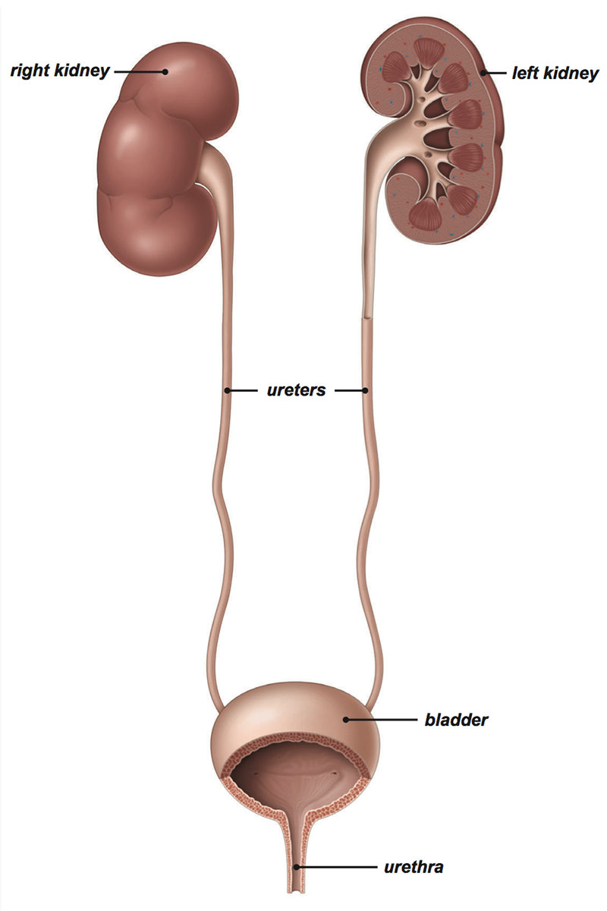
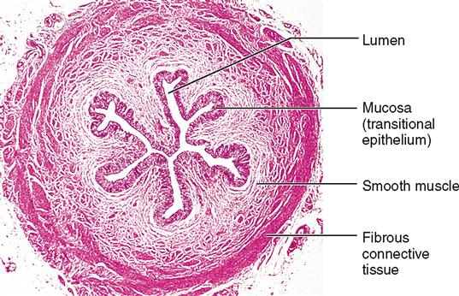
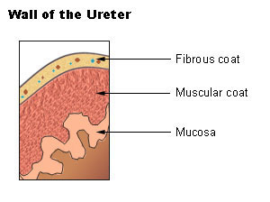
The ureters are paired fibromuscular tubes that transport urine from the renal pelves to the urinary bladder via peristaltic activity.
The ureters are composed of three tissue layers, including an outer adventitial layer, a central muscular layer, and an inner mucosal layer

Slide 18
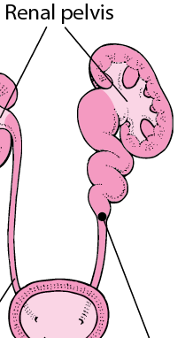
URETERAL OBSTRUCTION
انسداد الحالب يؤدي الى: الزيادة في الضغط التي تنتقل إلى الأنابيب الكلوية والكبيبات، وانخفاض تدفق الدم، انخفاض في معدل الترشيح الكبيبي من خلال تفاعل معقد لمجموعة متنوعة من الوسط الوعائي. يحدث أيضًا تدفق كريات الدم البيضاء (البلاعم والخلايا اللمفاويةT) في الكلیة. تطلق البلاعم الانزيمات المحللة للبروتينات والسيتوكينات التي قد تؤدي إلى تجنيد وتنشيط الأرومة الليفية fibroblasولها آثارسلبية على تدفق الدم الكلوي. قد تساهم الخلايا الليفية المنشطة بدورها في تطور:
1. التليف الخلالي interstitial fibrosisأو
2. تصلب الكبيبات.glomerulosclerosis.
These are the results of ureteral obstruction

Slide 19
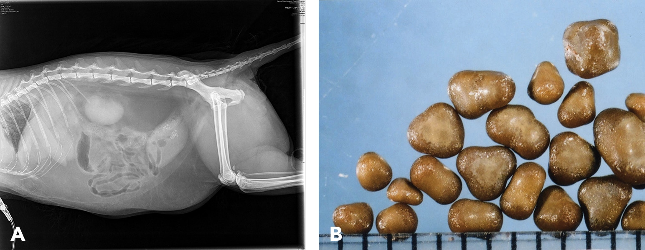
Feline Ureterolithiasis
Obstructive ureterolithiasis is one of the most common reasons for performing ureteral surgery, especially in cats.
many clinicians attempt to diurese the patient for some amount of time (1 to 4 days) before surgery, and some have attempted to induce relaxation of ureteral smooth muscle to get the ureterolith to move into the urinary bladder.

Slide 20
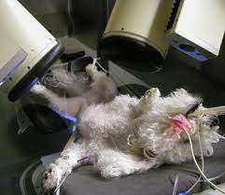
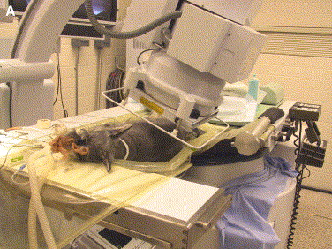
Lithotripsyتفتيت الحصى
Extracorporeal shockwave lithotripsy تفتيت الحصى بالموجات الصدمية خارج الجسم to fragment feline ureterolithiasis has not been widely used because it may result in renal injury when applied to concomitant nephroliths.
.لم يتم استخدامه على نطاق واسع لأنه قد ينتج عنه في إصابة الكلى عند تطبيقه على حصوات الكلى المصاحبة .
Localization of the ureterolith(s) is most commonly performed using abdominal ultrasonography

Slide 21
Surgery
it has been determined that diuresis has failed to move the calculus, a ureteral resection and reimplantation or, less commonly, ureterotomy is performed
Complications
Urine leakage is the most common postoperative complication
End-to-side ureteral reimplantation.
closure of a feline ureterotomy after removal of a proximal ureterolith

Slide 22
Ureteral Neoplasia
Primary ureteral neoplasia is quite rare in dogs and has not been reported in cats. Secondary involvement of a ureter by tumors of the urinary bladder or a kidney is more commonly reported.
Ureteral Trauma
Ureteral trauma is uncommonly reported and, when it occurs, is most often iatrogenic and associated with ovariohysterectomy

Slide 23
Urinary Bladder

Slide 24
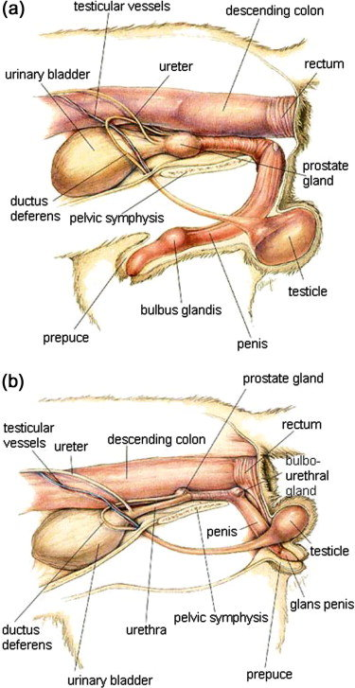
The bladder is a reservoir for urine and it varies in size, depending on the volume it contains.
In dogs, The position of the bladder is variable, lying just cranial to or within the pelvic canal when empty
and extending cranially along the ventral abdominal wall as it distends.
In cats, the bladder remains within the caudal abdomen, even when empty
dog
cat

Slide 25
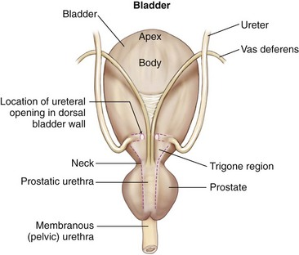
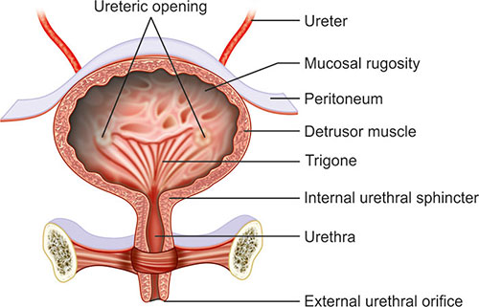
The bladder has an apex, body, and neck
Each ureter tunnels obliquely for a short distance through the dorsolateral bladder wall before opening into the bladder through a narrow, oval orifice.
The trigone is the internal region between the ureteral openings in the dorsal bladder wall and the proximal urethral opening at the bladder neck
Leaving the trigone intact is important for bladder mucosal regeneration because the regenerating cells arise from the epithelium of the terminal ureters and urethra.
Dogs may regain normal bladder function in the months after a large partial cystectomy.

Slide 26
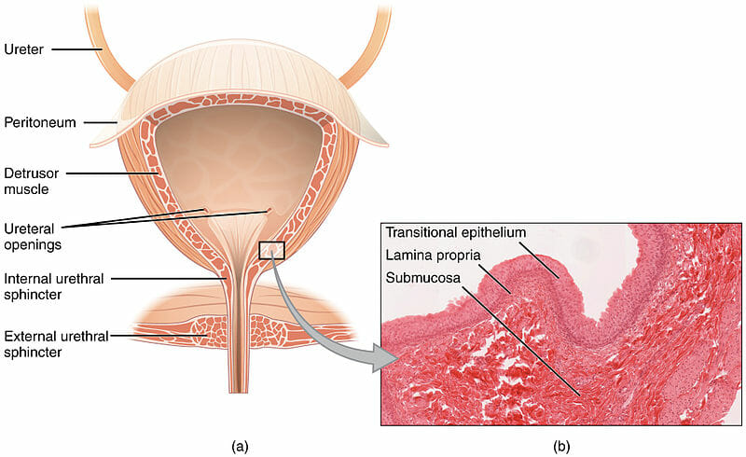
The urothelium of the bladder consists of mucosa composed of transitional epithelial cells, and submucosa, which contains connective tissue.
The urothelium is covered by a layer of smooth muscle (detrusor muscle).
The detrusor muscle has oblique, inter-digitating muscle fibers that are continuous with the smooth muscle of the urethra, so there is no anatomically distinct internal sphincter at the vesicourethral junction.
The serosa is the outermost layer of the bladder.
The normal bladder has a relatively thin wall but becomes thickened when diseased.

Slide 27
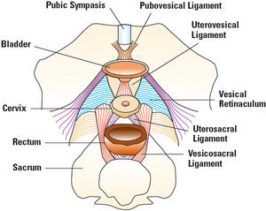
The ventral median ligament, which can be cut before cystotomy, is a very thin structure connecting the bladder to the linea alba and pelvic symphysis. In fetuses, this ligament contains the urachus.
The lateral ligaments of the bladder attach to the pelvic walls and contain fat along with the distal portion of the ureter and umbilical artery on each side. The lateral ligaments should be identified and avoided during dissection around the bladder to prevent iatrogenic damage to the ureters.

Slide 28
BLADDER SURGERY PRINCIPLES
Wound Healing, Suture Material, and Suture Patterns
The normal bladder heals quickly, with mucosal defects healing in 5 days and full-thickness defects regaining 100% of normal tissue strength in 14 to 21 days.
Monofilament suture material is recommended because it causes less tissue drag in delicate bladder tissue than multifilament suture and fewer bacteria adhere to monofilament suture compared with multifilament suture.
The recommended suture size for use in viscera in small animal surgery ranges from 1 to 2 metric (3-0 to 5-0), with the final choice for bladder surgery depending on the size of the animal, thickness of the bladder wall, and strength of the suture material selected.

Slide 29
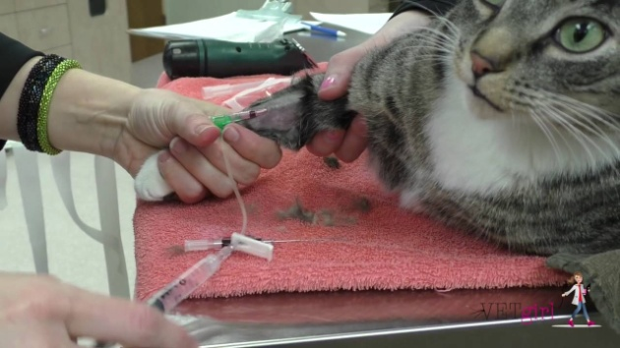
Antibiosis
Surgery that involves entry into the bladder in the absence of infected urine is classified as clean contaminated.
Most urinary tract pathogens originate from
the surface of the skin
the gut
ascend from the urethral orifice
(e.g., E. coli, Proteus spp., Staphylococcus intermedius)
A broad-spectrum, bacteriocidal, non-nephrotoxic antibiotic, such as amoxicillin clavulanate, or a third-generation cephalosporin is recommended for surgical prophylaxis.
The antibiotic should be given intravenously (IV)

Slide 30

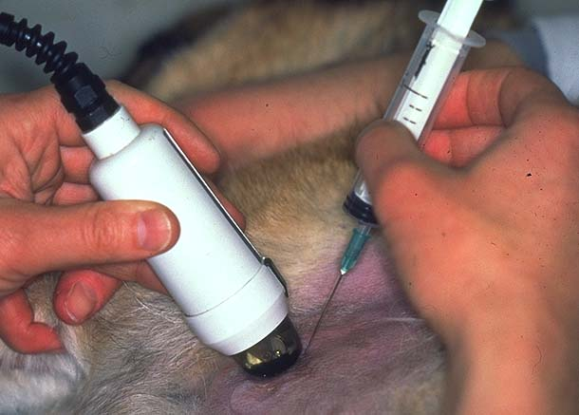
SURGICAL BLADDER CONDITIONS
Bladder Rupture
The bladder is the most common site of urinary tract rupture after trauma
It may occurs secondary to trauma; severe cystitis; bladder neoplasia; urethral obstruction by calculi or tumor; as a complication of bladder surgery; or iatrogenically.
Diagnosis:
Abdominocentesis to obtain a sample of abdominal fluid (urine).
Abdominal ultrasonography to guide abdominocentesis, and to provide information on the likely source of the urinary tract rupture.
Abdominal radiography may reveal decreased serosal detail because of urine accumulation in the abdomen and a small or absent bladder

Slide 31
Treatment
A soft tube drain that can be attached to a closed, sterile collection system may be used as an abdominal drain.
The drain is introduced into the abdomen using careful aseptic technique over a region of the ventral midline injected with local anesthetic.
peritoneal dialysis can be performed by instilling warmed isotonic fluid into the abdomen 20 mL/kg is infused and left in situ for 45 minutes before being drained out.
This process can be repeated hourly until dehydration, azotemia, acid–base and electrolyte imbalances, and the animal’s vital parameters have stabilized, then the animal is considered stable for anesthesia, exploratory laparotomy is performed to identify and repair the defect in the bladder (cystostomy).
prognosis for urinary tract rupture after trauma is more likely to be governed by the extent and severity of multiple other injuries.

Slide 32
Bladder Calculi
Urolithiasis is common in dogs and cats. Uroliths are composed of one or more mineral types. Suture material in the lumen of the bladder may act as a nidus for the formation of cystic calculi.
The majority of canine and feline uroliths are either struvite (magnesium ammonium phosphate) or calcium oxalate.
Clinical signs resulting from cystic calculi include hematuria, pollakiuria, stranguria, and dysuria and are common to most diseases of the lower urinary tract.
Ultrasonography are the most sensitive techniques for detection of calculi
Surgical cystotomy is the most common method for removal of cystoliths.

Slide 33
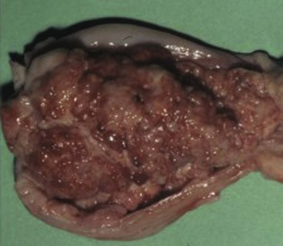
Bladder Neoplasia
Bladder neoplasia is rare in dogs, accounting for approximately 1% of all canine neoplasias, and is even less frequent in cats.
The bladder is the most common site for neoplasia in the urinary tract of dogs and the second most common site (after renal lymphoma) in cats.
Transitional cell carcinoma is the most commonly identified bladder neoplasia in dogs and cats.
Ultrasonography is a very sensitive method of imaging bladder masses.
Treatment: cystectomy may be performed in combination with chemotherapy.

